Slide 1
Snake game with reinforcement learning

Slide 2
CONTENTS
Introduction
Tools
Code description
Result

Slide 3

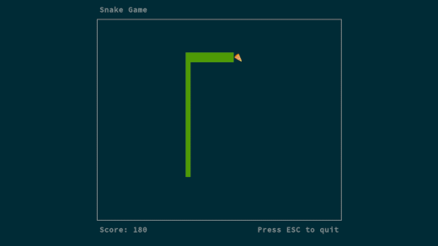
DID YOU GUYS REMEMBER THIS ?

Slide 4
INTRODUCTION
Reinforcement learning is a machine learning method where an agent learns to act in an environment depending on the rewards and punishments it gets.
Using different algorithms, an agent is trained to complete a task without any human interaction.

Slide 5

TOOLS
For this project, we are using Q-learning algorithm and few more let’s discuss them.
Q- algorithm is a value based algorithm and it updates the value based on the Bellman equation.
This equation calculates the next maximum reward based on a certain action at each state. The goal is to receive the maximum reward.
In this we used some of the important python libraries like
pygame and pytorch.
This Photo by Unknown Author is licensed under CC BY

Slide 6


PYGAME : Among the handful of other game development libraries available for python . Pygame is by far is best and most popular of them all. Pygame is built on top of SDL(Simple Direct Media Layer) , which provides low level access to computer hardware.
PyTorch : This is another python library and it is a open source machine learning library used for developing and training neural network based on deep learning models and machine learning models .

Slide 7
Code description
The project is divided into four scripts . Each script has its own functionality .
main.py
Agent.py
Model.py
PlotResult.py

Slide 8
REWARD :
eat food = +10
game over = -10
else = 0
ACTION:
[1,0,0] = STRAIGHT
[0,1,0] = RIGHT
[0,0,1] = LEFT
STATES(11 VALUES) :
[danger straight , danger left , danger right ,direction right , direction left , direction up , direction down , food left , food right , food up , food down]

Slide 9
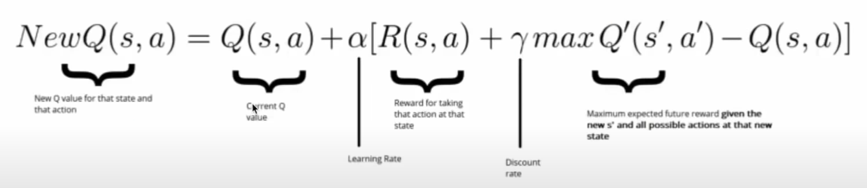
(Deep) q - learning
Q-value = quality of action
0. Init Q value (= init model)
1. Choose action(model.predict(state))
2. Perform action
3. Measure reward
4. Update Q value (+ train model)
Repeat
BELLMAN’S EQUATION

Slide 10
Main File
In this file, we are using one class to define all the functions needed for the graphics. We are also adding functions for placing the food, detecting collisions, taking the next step, and moving into that direction. First, we import some necessary libraries and define some constants.

Slide 11
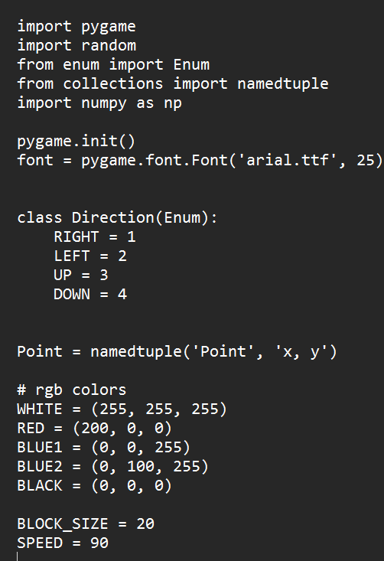
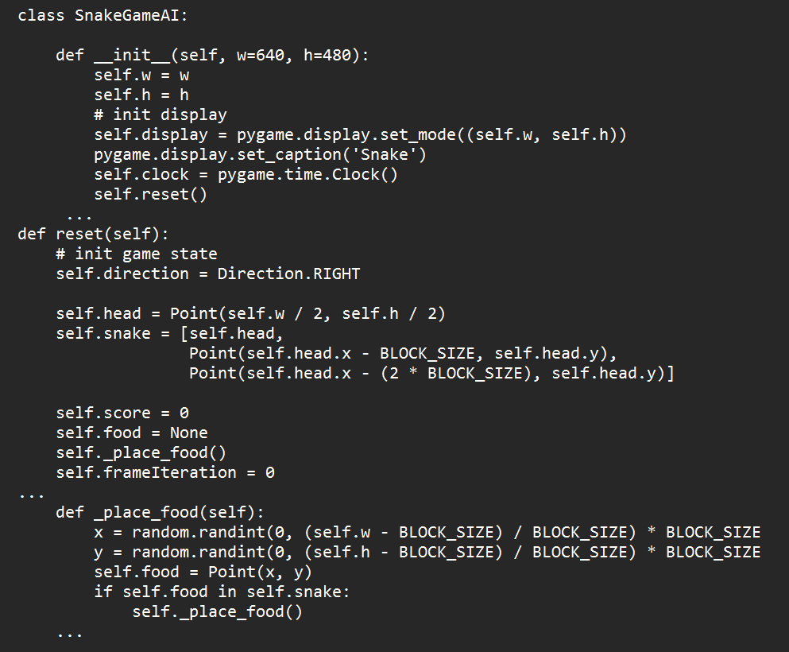
Using namedtuple, we create the dictionary to define x and y axis of an object. We set the colors, the size of the blocks or the spaces this window will contain, and the speed which can be changed as preferred.
Here we set the display for the game. The reset function will restart the game after each collision. The reset function starts or restarts the game. The initial direction is set to Right, the axis of the head is calculated, and the snake is created as a list. As we start the game, the score is set to 0, the iteration of the frames is set to 0, and we place a new food.

Slide 12
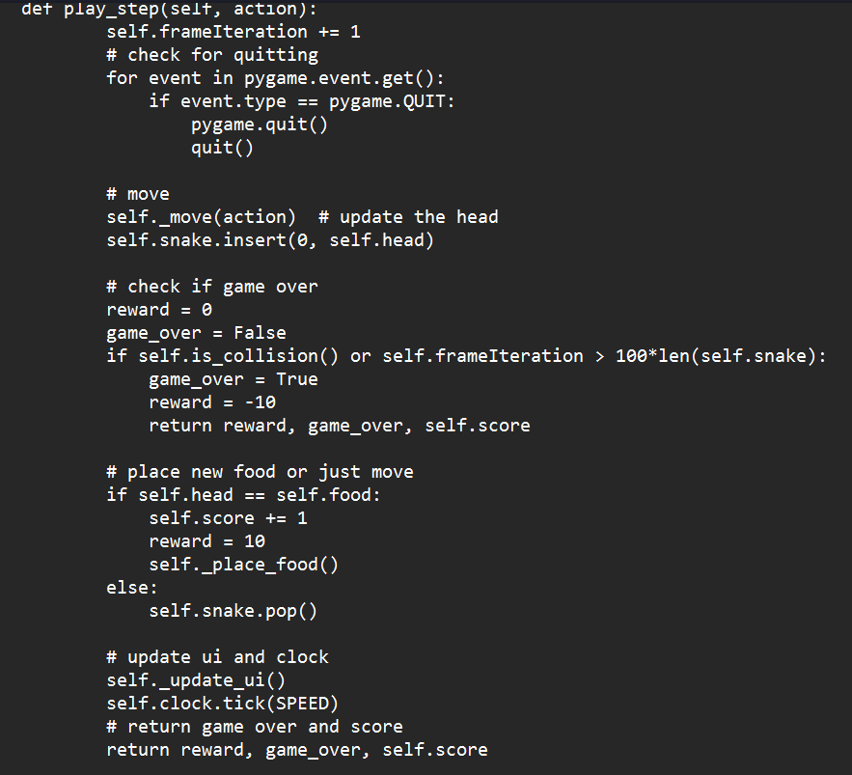
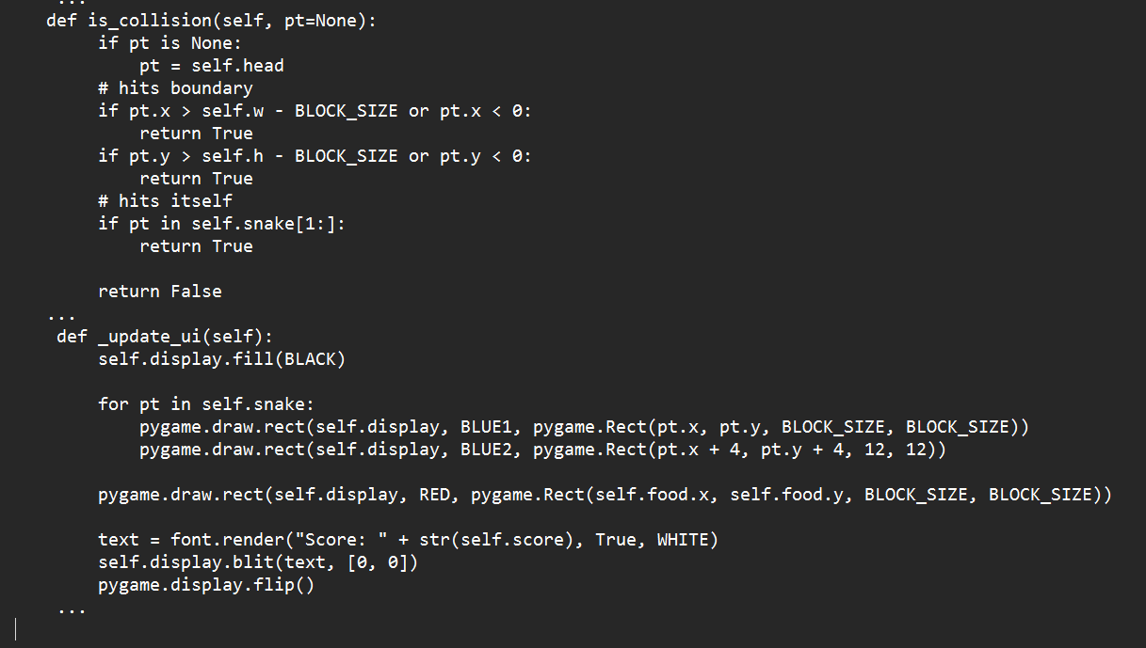

Slide 13
MODEL FILE
For the model, we will use Pytorch to build the neural network. We will import the libraries needed for this file.
It is a feed forward neural network with an input layer, hidden layer and output layer.
We creating a class to build the model and save it to the directory.
Pytorch helps us to easily build and save the neural network model using its built-in functions.

Slide 14
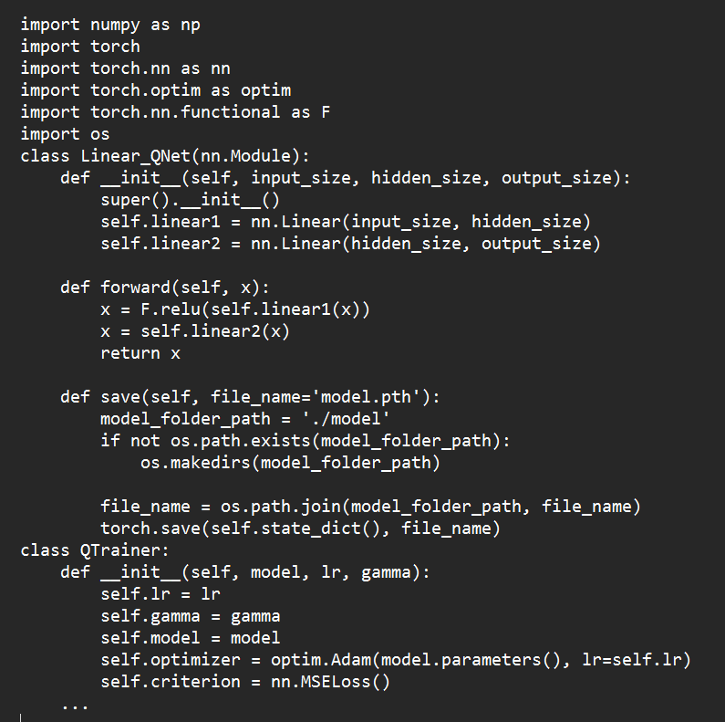
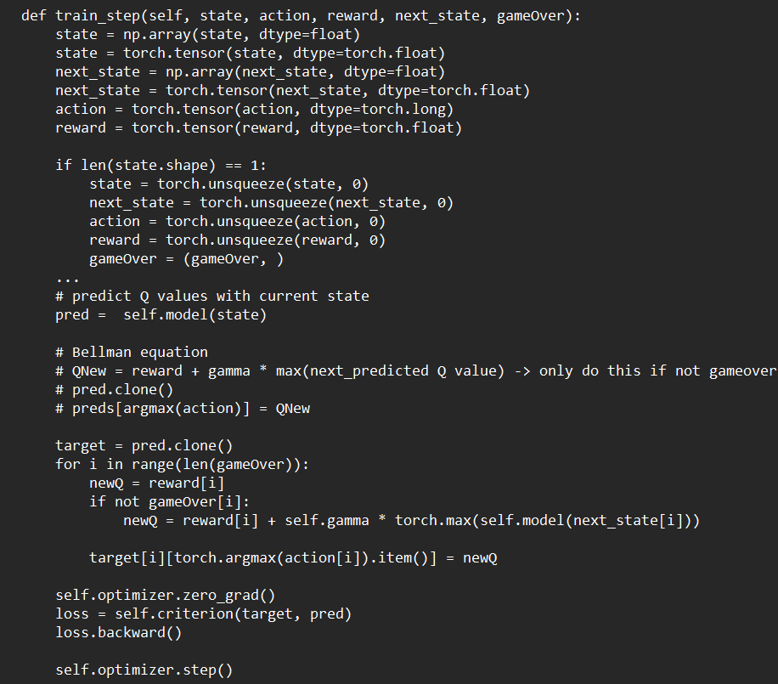
MODEL FILE

Slide 15
AGENT FILE
We need to import libraries and set constants for this file as well.
We use Pytorch and other classes and methods from other files in this file. We assign maximum meory size, batch size, and learning rate.
Now, we create the Agent class. In the model, the 11 and 3 values are for the states and actions. We have 11 states for the snake to be and 3 actions(straight, right-turn, left-turn) for the snake to take.
To get the state of the agent, we define a method and return the values as a numpy array.
We set the left, right, up, down positions for the snake-head and we also set the directions. To check the state, we check for dangers straight, right-turn, or left-turn, then we check the direction the snake is moving, and the food location. Each of these will return True or False value.

Slide 16
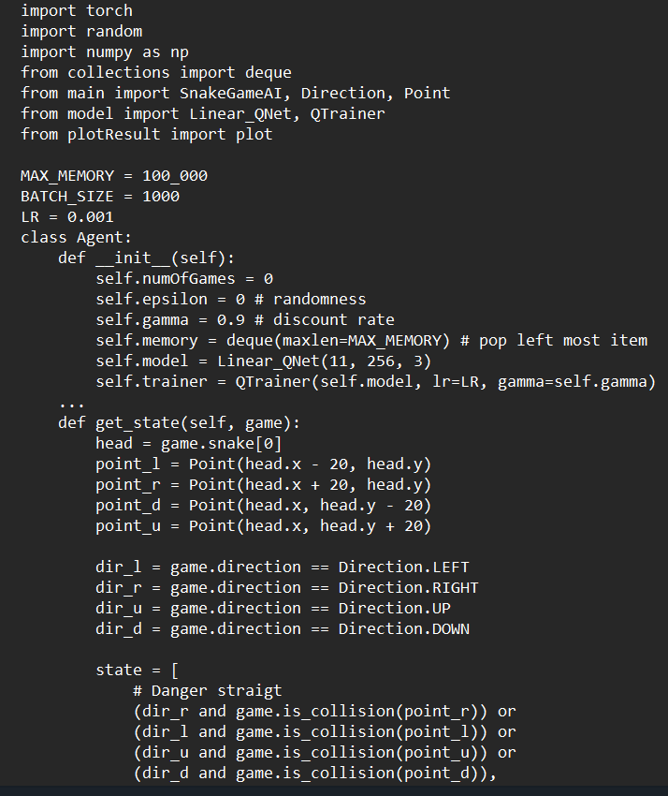
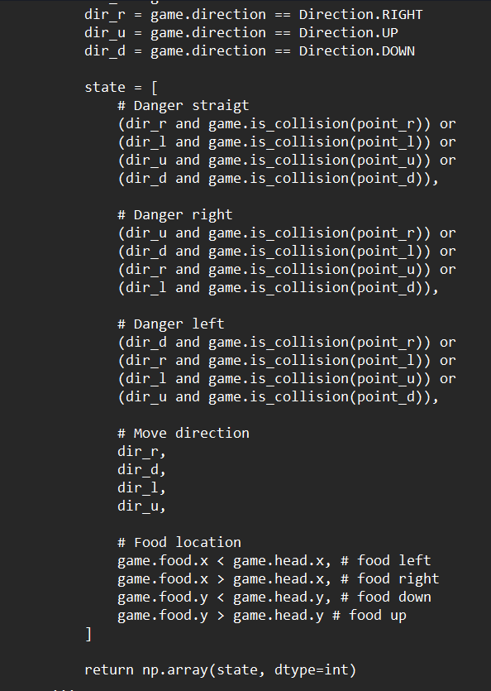
AGENT FILE

Slide 17
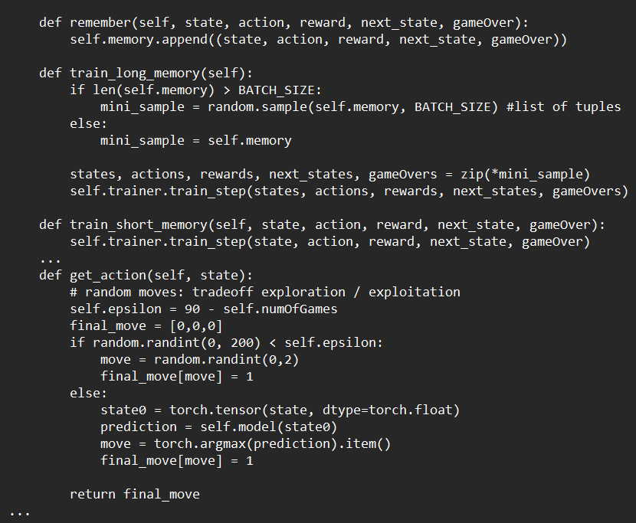

Slide 18
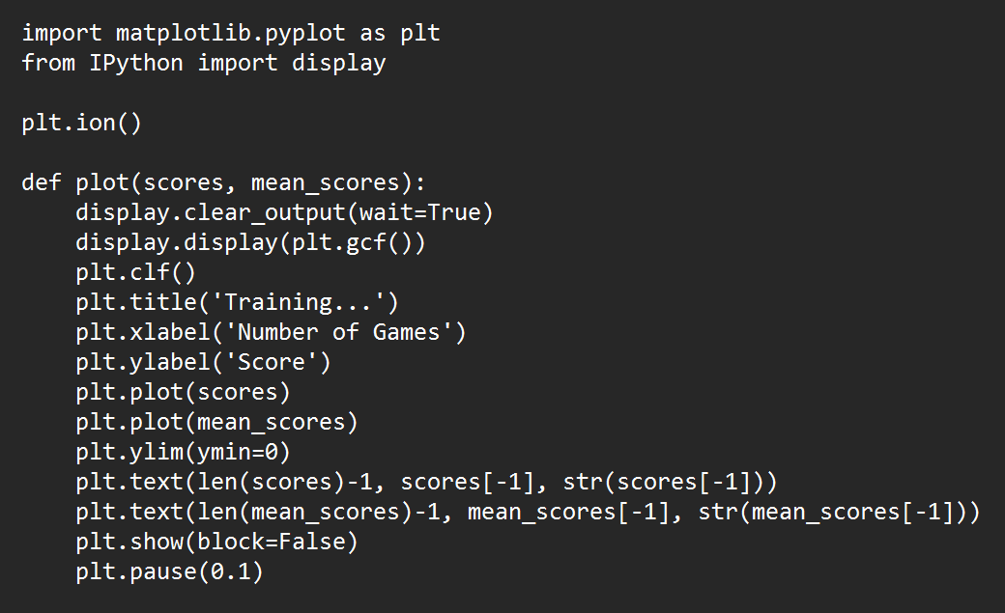
Plotresult file

Slide 19
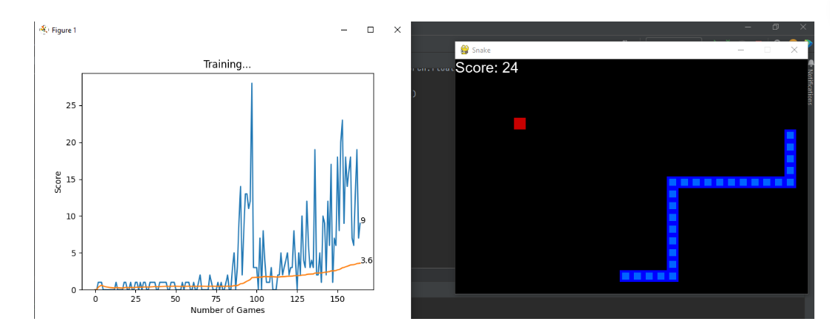
Results
We use matplotlib for plotting the graph for training . Ion() method turns on the interactive mode .
We receive the scores and mean-scores from the agent and display the graph which shows the change of score as the game continues.
This shows the improvement of the snake’s performance.

Slide 20
THANK YOU
Sowjanya Kamineni
Venkata Susmitha Duggineni

